Slide 1
A Comparative Study on Aesthetic Representation of The Picture of Dorian Gray: Based on Rong Rude’s and Huang Yuanshen’s Translations
汇报人：林妮 20221210020
In Pursuit of Excellence in Interpreting and Translation
译无止境，臻于至善

Slide 2
  Contents
01
Introduction
02
Literature Review
03
Theoretical Framework
04
Case Analyses
05
Key Findings

Slide 3
Introduction
1.1 Research background
Oscar Wilde’s The Picture of Dorian Gray is a classic work of Aestheticism (乔国强，2020) and it fully reflects Wilde’s unique artistic philosophy.
The translation of this novel into Chinese holds significant value for cross-cultural communication.
1.2 Research questions
(1) How do the two Chinese translations represent the aesthetic features of the original novel?
(2) How do readers perceive and evaluate the aesthetic features of these two Chinese translations?

Slide 4
Introduction
1.3 Research Significance
Theoretical Significance:
This thesis can enrich research on the translation of The Picture of Dorian Gray in terms of the aesthetic representation at the phonetic and lexical level, and the aesthetic representation of emotions and symbols.
This thesis can shed light on the reader’s reception and perception of Rong Rude’s and Huang Yuanshen’s translations.
Practical Significance:
This research can rovide translators with practical reference regarding aesthetic representation methods in literary translation.

Slide 5
Literature Review
2.1 Previous Studies on Translation Aesthetics
Rersearch focus:
aesthetic translation theories (雷祎，1993；曾利沙，2006)
aesthetic thoughts of certain translators (汪璧辉、辛红娟，2023)
discussion of aesthetic features or beauty of the translation works (Woods & Wyman, 2014; Keinänen, 2018; Zhou, 2022)
Research methods: mainly qualitative methods (文佳等，2018); a small number of studies have applied quantitative data (Keinänen, 2018; 胡艳红、李文慧，2022).

Slide 6
Literature Review
2.2 Previous Studies on the Translation of The Picture of Dorian Gray
Theoretical perspectives: literary stylistics (李玉辉，2009); translation aesthetics (曹欢，2011); cognitive narratology (曾妍，2022), etc.
Research focus:
specific translation details, e.g. the translation of environmental descriptions (张露，2019)
translators, such as translator’s identity (戴如梦，2021) and translation thoughts (张顺生、丁后银，2023)
translation strategies and methods (张丽，2009)
Research methods: mainly descriptive and qualitative (曾妍，2022)

Slide 7
Literature Review
2.3 Summary
Previous researchers (张丽，2009；曹欢，2011；张顺生、丁后银，2023) have studied the beauty of rhyme, diction, rhetorical devices, sentence pattern and images of the original novel. However, there is a lack of research in terms of the representation of aesthetic information such as rhythm, emotions and symbols in the translation of The Picture of Dorian Gray.
Studies that consider readers’ reception are scarce, and most existing research relies heavily on textual analysis, lacking empirical data based on actual readers’ responses. Therefore, it is necessary to incorporate empirical methods to enrich this dimension.

Slide 8
Theoretical Framework
According to Liu (刘宓庆，2020), aesthetic constituents of aesthetic object of translation (TAO) contain all the beauty of the ST, which can be analysed from the following two aspects: formal system and non-formal system.
The formal system includes aesthetic features at the phonetic level, character level, lexical level, and syntactic and paragraph level.
The non-formal system includes aesthetic features of emotion, aspiration, images and symbol.
刘宓庆. 翻译美学导论[M]. 北京：中译出版社，2020.

Slide 9
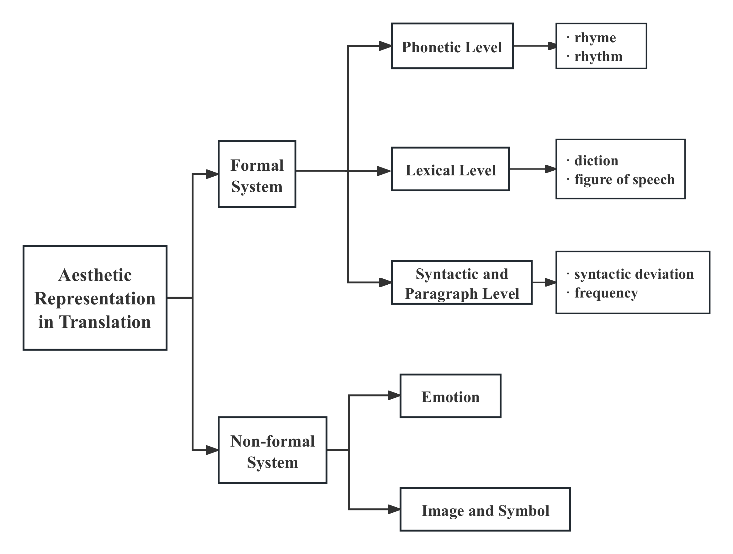
Analytical Framework

Slide 10
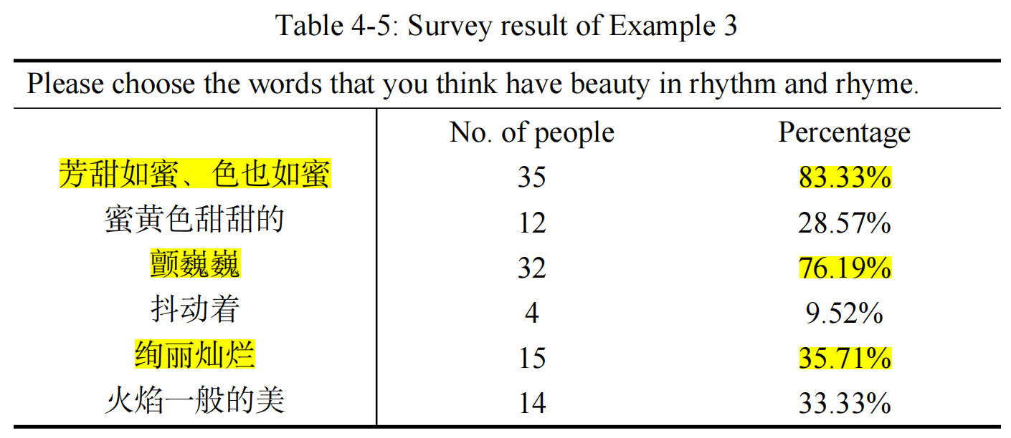
Phonetic level (formal system)
ST: Henry Wotton could just catch the gleam of the honey-sweet and honey-coloured blossoms of a laburnum, whose tremulous branches seemed hardly able to bear the burden of a beauty so flame-like as theirs.
TT1: 他从放沙发的那个角落只能望见一丛芳甜如蜜、色也如蜜的金链花的疏影，它那颤巍巍的枝条看起来载不动这般绚丽灿烂的花朵；
TT2: 从沙发的角落望出去，正好看得见蜜黄色甜甜的金莲花在闪烁。抖动着的树枝，似乎很难承载花儿火焰一般的美。
(42 respondents)
ST: alliteration, assonance and repetition
TT1: four-Chinese-character structures, reduplication and end-rhyme
TT2: reduplication

Slide 11
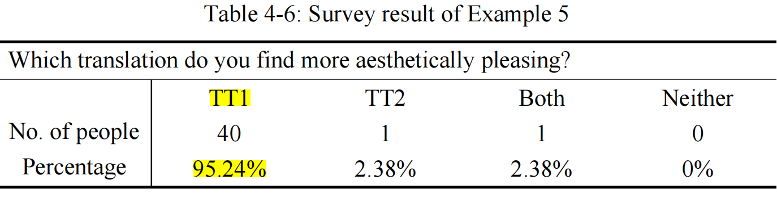
Lexical level (formal system)
ST: Her body swayed, while she danced, as a plant sways in the water. The curves of her throat were the curves of a white lily. Her hands seemed to be made of cool ivory.
TT1: 她跳舞的时候身姿摇曳，犹如一茎芦苇在水中荡漾。她颈脖的曲线酷似洁白的百合花，两条胳臂简直是用象牙雕成的。
TT2: 她跳舞时摆动着身子，好像一棵植物在水中摇曳一样，喉部的曲线是洁白的百合花的曲线，手似乎是冷色的象牙做的。
(42 respondents)
Diction:
TT1: literary and refined
TT2: direct and literal

Slide 12
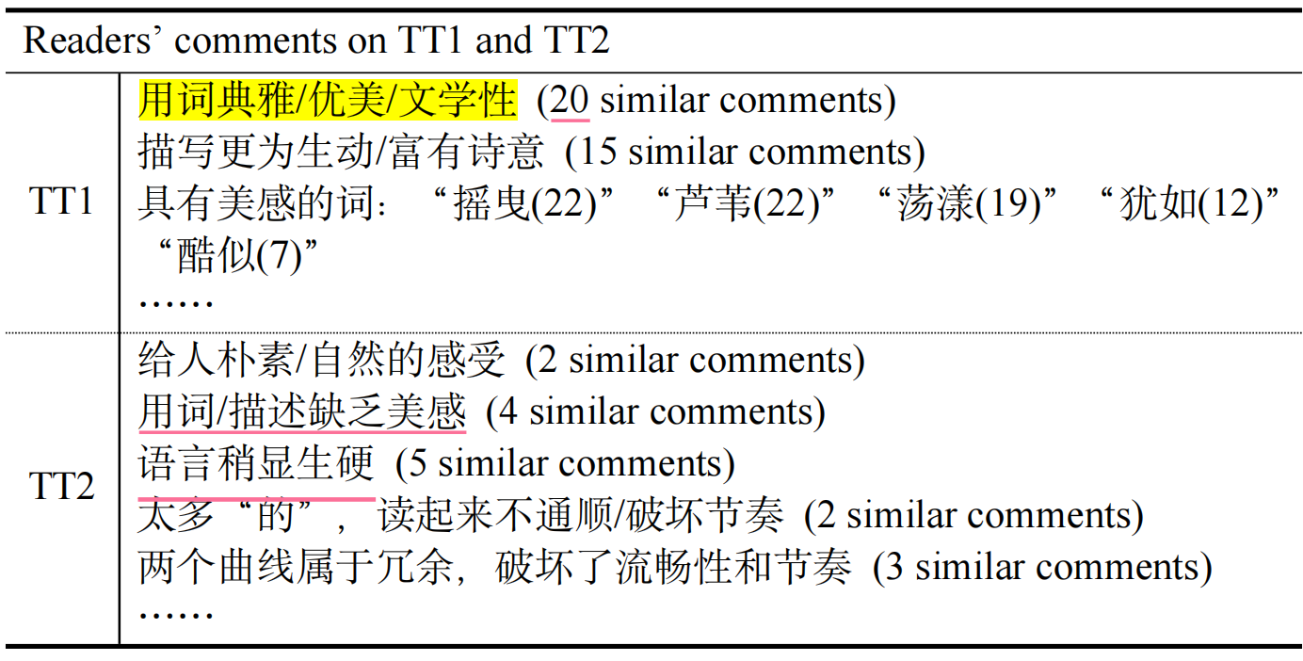
Lexical level (formal system)
TT1: 她跳舞的时候身姿摇曳，犹如一茎芦苇在水中荡漾。她颈脖的曲线酷似洁白的百合花，两条胳臂简直是用象牙雕成的。
TT2: 她跳舞时摆动着身子，好像一棵植物在水中摇曳一样，喉部的曲线是洁白的百合花的曲线，手似乎是冷色的象牙做的。
(42 respondents)
95.24% prefer TT1
2.38% prefer TT2

Slide 13
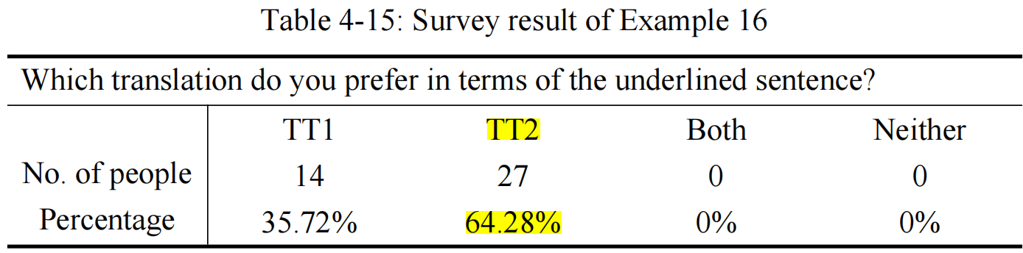
Image and Symbol (non-formal system)
ST: Time is jealous of you, and wars against your lilies and your roses. You will become sallow, and hollow-cheeked, and dull-eyed. You will suffer horribly. . .
TT1: 时光妒忌你，向你脸上的百合花和玫瑰花不断进攻。你的面色会发黄，两颊会凹陷，眼神会变暗。你会痛苦不堪……
TT2: 时间妒忌你，跟你的美貌作对。你会脸色灰黄，两颊下陷，目光迟钝。你会感到无限痛苦……
(42 respondents)
Flower symbols
TT1: literal translation
TT2: free translation

Slide 14
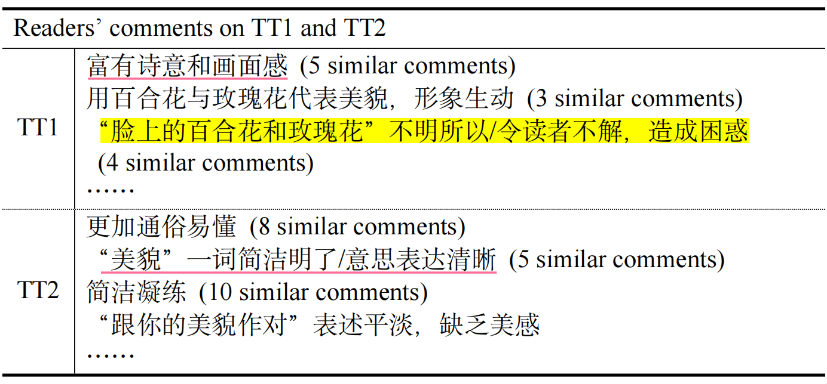
Image and Symbol (non-formal system)
TT1: 时光妒忌你，向你脸上的百合花和玫瑰花不断进攻。你的面色会发黄，两颊会凹陷，眼神会变暗。你会痛苦不堪……
TT2: 时间妒忌你，跟你的美貌作对。你会脸色灰黄，两颊下陷，目光迟钝。你会感到无限痛苦……
(42 respondents)
35.72% prefer TT1
64.28% prefer TT2

Slide 15
Key Findings
In the formal system:
At the phonetic level, Huang Yuanshen’s translation uses short clauses to effectively reproduce the fast rhythm of the ST, whereas Rong Rude’s use of four-Chinese-character structures, reduplication, and end-rhyme better reproduces the ST’s beauty of sound. Survey results indicate that Rong’s version is perceived as more beautiful in rhyme and rhythm.
At the lexical level, Rong’s translation better reproduces the ST’s refined diction and colloquial dialogue. Huang’s concise language and balanced phrasing more effectively reproduce the humour of the ST, making his version more popular among the respondents.
At the syntactic and paragraph level, Huang’s structured and balanced syntax more effectively reproduces the beauty of the ST, and is preferred by the respondents.

Slide 16
Key Findings
In the non-formal system:
The excessive length of certain expressions in Rong’s translation impairs readability and weakens emotional expression. Regarding the aesthetic representation of the ST’s images and symbols, literal translations may result in a loss of their symbolic beauty and even cause misunderstanding. The survey result indicates that the respondents prefer translations that employ vivid, refined language or adopt a free translation method to represent the original symbolism, rather than those that use a literal translation method.

Slide 17
References
[1]Huang, F. R. Translation aesthetics in children’s literature [J]. Theory and Practice in Language Studies, 2017, (7): 1327-1332.
[2]Jawad, H. A. Sound symbolism, schemes & literary translation [J]. Babel, 2010, (1): 47-63.
[3]Keinänen, N. M. Receptive aesthetic criteria: Reader comparisons of two Finnish translations of Hamlet [J]. Multicultural Shakespeare: Translation, Appropriation and Performance, 2018, (1): 23-42.
[4]Kwok, V. Ethics and aesthetics are one Creative literary translation in the post-modern world [J]. Babel, 2019, (2): 249-263.
[5]Peters, K. Examining form and meaning: A prosodie analysis of three poems by Delmira Agustini in English translation [J]. Babel, 1997, (3): 206-232.
[6]Saldanha, G. & O’Brien, S. Research Methodologies in Translation Studies [M]. New York: Routledge, 2014.
[7]Wales, K. A Dictionary of Stylistics [M]. New York: Routledge, 2011.
[8]Wilde, O. The Picture of Dorian Gray [M]. London: Alma Classics, 2014.
[9]Woods, M. & Wyman, S. Aesthetic radicalism: Langston Hughes’s lost translation of Federico García Lorca’s Bodas de sangre/Blood Wedding [J]. Modern Drama, 2014, (4): 469-492.
In Pursuit of Excellence in Interpreting and Translation
译无止境，臻于至善

Slide 18
References
[10]Yu, Y., et al. A critical exploration of cultural and aesthetic representation of Shandong dialect translation in red sorghum [J]. Theory and Practice in Language Studies, 2024, (10): 3247-3256.
[11]Zhou, M. Towards a poetics of immersion in lyric translation: Aesthetic illusion and the translator as immersive reader in English translations of classical Chinese ci poetry [J]. Target, 2018, (3): 383-407.
[12]Zhou, R. A study on functional equivalence in translation of lyric prose — A case of autumn in Peiping by Zhang Peiji [J]. Theory and Practice in Language Studies, 2022, (2): 348-355.
[13]Zuhron et al. The strategy of translating Indonesian texts with cultural nuances into English [J]. Theory and Practice in Language Studies, 2023, (10): 2482-2489.
[14]奥斯卡·王尔德. 《道连·格雷的画像》[M]. 黄源深译. 南京: 译林出版社，2022.
[15]奥斯卡·王尔德. 《道连·葛雷的画像》[M]. 荣如德译. 上海: 上海译文出版社，2011.
[16]曹欢. 从翻译美学角度看小说翻译的审美再现[D]. 湖南师范大学，2011.
[17]杜建慧. 再论“翻译学”的界定[J]. 解放军外语学院学报，1998，（4）：95-98+109.
戴如梦. 翻译适应选择论视角下的译者身份研究[D]. 河南工业大学，2021.
In Pursuit of Excellence in Interpreting and Translation
译无止境，臻于至善

Slide 19
References
[18]戴如梦. 翻译适应选择论视角下的译者身份研究[D]. 河南工业大学，2021.
[19]范岳. 试谈文学翻译中的人物形象与美感[J]. 中国翻译，1985，（3）：5-8.
[20]顾延龄. 试论文学翻译与语言艺术[J]. 中国翻译，1989，（2）：14-18.
[21]胡东平、欧阳晴雯. 难与美：《水浒传》赛珍珠译本美学阐释[J]. 外语学刊，2022，（4）：67-71.
[22]洪明. 论接受美学与旅游外宣广告翻译中的读者关照[J]. 外语与外语教学，2006，（8）：56-59+65.
[23]胡永华. 唯美主义[J]. 外国文学，2013，（6）：94-102+159.
[24]胡艳红、李文慧. 《冰与火之歌：权力的游戏》汉译本之翻译美学视角研究[J]. 上海翻译，2022，（6）：85-89.
[25]刘宓庆. 翻译美学导论[M]. 北京：中译出版社，2020.
[26]刘宓庆. 翻译美学教程[M]. 北京：中译出版社，2016.
[27]刘宓庆. 翻译美学概述[J]. 外国语(上海外国语学院学报)，1986，（2）：48-53.
[28]刘宓庆. 翻译美学基本理论构想[J]. 中国翻译，1986，（4）：19-4.
In Pursuit of Excellence in Interpreting and Translation
译无止境，臻于至善

Slide 20
References
[29]连淑能. 英汉对比研究[M]. 北京：高等教育出版社，2010.
[30]刘世生、朱瑞青. 文体学概论[M]. 北京：北京大学出版社，2006.
[31]雷祎. 开拓与创新——刘宓庆的翻译理论研究述评[J]. 中国翻译，1993，（3）46-50.
[32]刘雯. 《道连·格雷的画像》语言戏剧性特色的翻译研究[D]. 华东师范大学，2008.
[33]李玉辉. 从文学文体学角度谈小说翻译[D]. 复旦大学，2009.
穆雷. 翻译研究方法概论[M]. 北京：外语教学与研究出版社，2010.
[34]穆雷. 翻译研究方法概论[M]. 北京：外语教学与研究出版社，2010.
[35]毛荣贵. 翻译美学[M]. 上海：上海交通大学出版社，2005.
[36]孟伟根. 戏剧翻译研究[M]. 杭州：浙江大学出版社，2012.
[37]乔国强. 论王尔德的唯美主义思想[J]. 上海大学学报(社会科学版)，2015，（6）：52-61.
[38]乔国强. 从唯美到现代：王尔德唯美主义思想的再认识[J]. 东北师大学报(哲学社会科学版)，2020，（6）：1-9.
[39]孙建成、温秀颖. 翻译美学思想与译作的审美重构——简评刘士聪文学翻译美学思想[J]. 中国翻译，2007，（3）：45-48+94.
[40]汪璧辉、辛红娟. 张柏然翻译美学实践及其思想[J]. 外语研究，2023，（6）：98-102.
In Pursuit of Excellence in Interpreting and Translation
译无止境，臻于至善

Slide 21
References
[41]魏姣. 操纵理论视角下对《道连格雷的画像》黄源深译本的思考[D]. 西安外国语大学，2012.
[42]文佳、牛海燕、姚欣. 翻译美学视域下《黄帝内经》回环辞格英译研究[J]. 中国中医基础医学杂志，2018，（11）：1628-1630+1645.
[43]伍小君. 诗歌翻译的接受美学观——兼评王维诗《送元二使安西》的四种英译文[J]. 外语与外语教学，2007，（10）：56-58.
[44]杨国强、吕世生. 典籍翻译中译者审美意识与译者行为关系探颐——以华兹生的典籍翻译为例[J]. 外语学刊，2023，（2）：62-70.
[45]余继英、郭建中. 美学理念——翻译理论与实践的桥梁——简评《翻译美学》[J]. 中国翻译，2006，（4）：53-56.
[46]杨明星、郑润宇. 马克思恩格斯翻译美学思想原典考论[J]. 中国翻译，2024，（6）：29-37+191-192.
[47]张保红. 文学翻译[M]. 北京：外语教学与研究出版社，2020.
[48]张成柱. 文学翻译中的美学问题[J]. 外语教学，1984，（2）：46-52.
[49]张丽. 文学翻译审美再现手段研究[D]. 广西师范大学，2009.
[50]张露. 识解理论视阈下《道林·格雷的画像》环境描写汉译研究[D]. 四川外国语大学，2019.
In Pursuit of Excellence in Interpreting and Translation
译无止境，臻于至善

Slide 22
References
[51]曾利沙. 论《翻译美学》的理论与方法论特征——从审美意识看文学翻译的译者主体性[J]. 上海翻译，2006，（3）：7-11.
[52]张顺生、丁后银. 黄源深的翻译美学艺术——以《道连·格雷的画像》的翻译为例[J]. 当代外语研究，2023，（4）：97-105.
[53]曾妍. 认知叙事学视角下《道林·格雷的画像》汉译对比研究[D]. 天津商业大学，2022.
[54]郑玉琪、郭艳红. 浅谈英文化妆品说明书之美学翻译[J]. 中国翻译，2005，（2）：72-74.
[55]祝一舒. 翻译艺术与求美之道——兼析许渊冲文学翻译“三美”论[J]. 外语与外语教学，2023，（1）：96-104+147.
In Pursuit of Excellence in Interpreting and Translation
译无止境，臻于至善

Slide 23
Thanks for watching!
In Pursuit of Excellence in Interpreting and Translation
译无止境，臻于至善

